Slide 1
Strengthening of Biotechnology Teaching, Training and Research IN UNIVERSITY AND COLLEGEs IN NORTH-EAST
Funded by DBT-HRD
Presented by:
Dr. B. B. Kakoti
Chairperson
Centre for Biotechnology & Bioinformatics
Dibrugarh University

Slide 2
Project Particulars
File No: IITG/P/DORD/01/DBT/DU (BT/HRD/01/002/2007)
Project Title: Strengthening of Biotechnology teaching, training and research in University and College in North East
Name of PI with Full address: Dr. B. B. Kakoti,
Chairperson,
Centre for Biotechnology & Bioinformatics
Dibrugarh University
Date of Start (As per date of Sanction Order): 18.09.2009

Slide 3
OBJECTIVES:
To generate competent local human resource
To develop infrastructure for teaching, training and research
Research and Development activities

Slide 4
Objective I:
To generate competent local human resource
Programmes offered by the Centre with the support of DBT-HRD:
M.Sc. Biotechnology (Till 2015-17)
Two-year (Four-Semester) Programme under the Choice-based Credit System (CBCS) with specialization in:
Medical Biotechnology
Pharmaceutical Biotechnology

Slide 5
Number of candidates awarded M.Sc. degree in Biotechnology from the Centre for Studies in Biotechnology, Dibrugarh University
Sl. No. | Year | No. of Students awarded M.Sc. Biotechnology
1 | 2007-2009 | 11
2 | 2008-2010 | 16
3 | 2009-2011 | 19
4 | 2010-2012 | 21
5 | 2011-2013 | 21
6 | 2012-2014 | 20
7 | 2013-2015 | 25
8 | 2014-2016 | 25
Total |  | 158
Alumni Status:
Pursuing PhD and Post-Doc in National and International Institutes
Placed in leading Biotechnology Companies (Through BCIL)
Developing bio-based enterprises (Biopesticide, Biofertilisers, Organic tea)

Slide 6
Merger of the Centre for Studies in Biotechnology and the Centre for Bioinformatics Studies to form the Centre for Biotechnology & Bioinformatics (2016)
Present academic programmes offered by the Centre:
M.Sc. Biotechnology and Bioinformatics (2016 onwards)
Two-year (Four-Semester) programme under the Choice-based Credit System (CBCS) with specialization in:
General Biotechnology
Pharmaceutical Biotechnology
Bioinformatics and Computational Biology

Slide 7
PhD in Biotechnology
Candidates awarded PhD degree in Biotechnology from the Centre till date
Sl No. | Name of the Candidate | Name of the Supervisor | Title of PhD thesis | w.e.f. | Remarks
01 | Ms. Sunayana Rathi | Prof. R.N.S.Yadav, CSB, DU | “Biochemical and Molecular Characterization of Indigenous Upland Rice (Ahu rice) of Assam in Relation of Dormancy” | 04.08.2008 | Awarded
02 | Mr. Pritom Chowdhury | (i) Prof. R.N.S.Yadav CSB,DU (ii) Dr. Siraj A.Khan RMRC, Lahoal, Dibrugarh | “Studies on the Genotype of West Nile Virus (WNV) Prevailing in Assam with Particular Reference to Envelope and Premembrane Glycoprotein” | 19.09.2008 | Awarded
03 | Mr. Bhaskar Jyoti Saikia | (i) Dr. S.K.Sharma, Scientist ‘E’RMRC,Lahoal (ii) Dr.R.K.Phukon, Scidntist ‘C’ RMRC, Lahoal, Dibrugarh | “Studies on Molecular Epidemiology of lung cancer with special reference to xenobiotic metabolic pathway gene, DNA repair gene and cell cycle gene in Manipur and Mizoram, India” | 23.06.2011 | Awarded

Slide 8
Sl No. | Name of the Candidate | Name of the Supervisor | Title of PhD thesis | w.e.f. | Remarks
04 | Mr. Ridip Hazarika | Prof. B. Neog, Deptt. of Life Sciences, Dibrugarh University | “Studies on Intraspecific Genetic Diversity in Capsicum Chinese Jacq. (Bhut Jolokia) through Molecular Techniques” | 26.03.2012 | Awarded
05 | Mr. Jitendra Sharma | 1. Dr. Prafulla Dutta, Scientist ‘F’, RMRC,Lahoal, Dib 2. Dr. Siraj Ahmed Khan, Scientist ‘D’ RMRC, Lahoal,Dib | A Study of Genetic Polymorphisms and Gene Flow among currently used Antimalarial Drug Resistance Associated Plasmodium falciparum field Isolates in different Malaria Endemic Areas of Assam | 22.08.2012 | Awarded
Total number of candidates registered for PhD in Biotechnology
in the Centre for Biotechnology & Bioinformatics: 39
The Centre has also started receiving applications for doctoral research work from Overseas Scholars through Indian Council for Cultural Relations (ICCR) and have granted admission of the same.

Slide 9
The facility developed under the project has been effectively used by teachers in teaching and training of Postgraduate Students and Research scholars of the allied Departments of the University as well, viz.:
Department of Pharmaceutical Sciences
Department of Chemistry
Department of Life Sciences
Department of Petroleum Technology
Department of Statistics
Department of Mathematics
The facility has also been extended to students and scholars from other Institutions/Universities of the country.
Seminar/Symposia organized with DBT-HRD support
Sl No | Title | Duration | Level of Participants | No. of Participants | Resource Person Invited
1 | National Seminar on Biotechnology Research for Sustainable Development | Feb 27-28, 2012 | Research Scholar and Teachers | 20 | Prof. B. K. Konwar, Vice-Chancellor, Nagaland University Dr. J. Mahanta, Director, RMRC, Dibrugarh Prof. U. C. Banerjee, NIPER, Mohali
2 | Workshop on Basic Tools and Techniques in Biotechnology and Bioinformatics | March 21-22, 2016 | Under graduate students | 27 | Prof. Samir Bhattacharya, INSA Professor Emeritus Professor, Dept of Zoology Viswa Bharati University, Shantiniketan, West Bengal

Slide 10
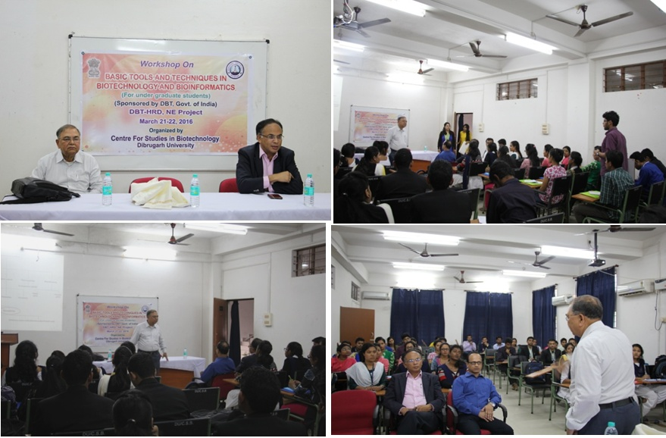

Slide 11
Objective II
To develop infrastructure for teaching, training and research
2 dedicated laboratories for M.Sc. students
1 Microbiology Laboratory
1 Animal Cell Culture facility
1 Molecular Biology lab
1 Cell Biology Lab
1 Central Instrumentation Facility
ICT-enabled classrooms
Bioinformatics Infrastructure Facility (BIF)
Rooms for faculty
Infrastructure to access DBT DeLCON
Creation of additional floor space of 3,200 Sq.ft with University support for the Cell Culture Facility, Molecular and Cell laboratories and Faculty Chambers.

Slide 12
Major Instruments of the Centre:
High Performance Liquid Chromatography (HPLC), Agilent, Germany
Fermentor (2L), Eppendorf, Germany
Thermocycler C1000, BIORAD, USA
Gel Documentation System, BIORAD, USA
High-Speed Cooling Centrifuge, Sigma, Germany
Rotary Evaporator, IKA, Germany
Inverted Fluorescence Microscope, Zeiss, Germany
Water Purification System, Sartorius, Germany
Bio-safety Level II (BSL-II) Facility, Labtech Diahan, South Korea
Probe Sonicator, Sartorius, Germany
Leica ATC 2000 Microscope, Leica, Germany

Slide 13
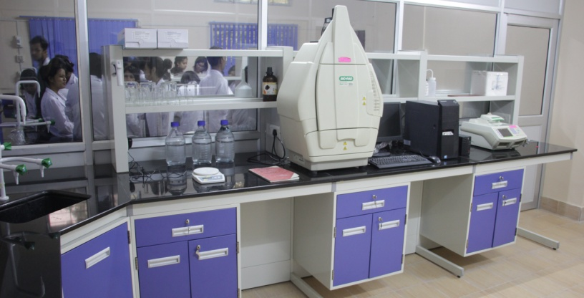
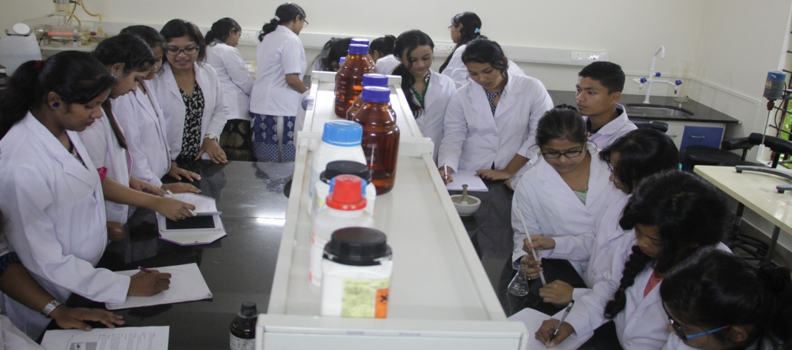
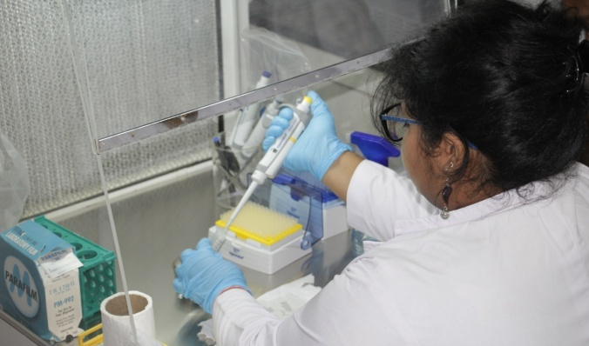
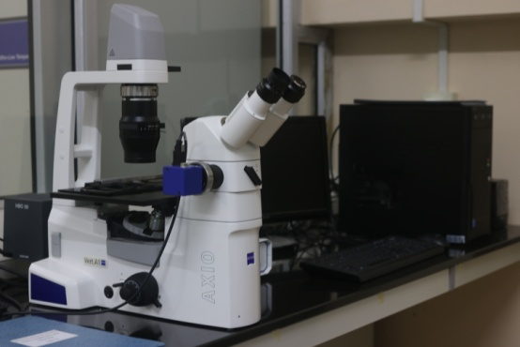
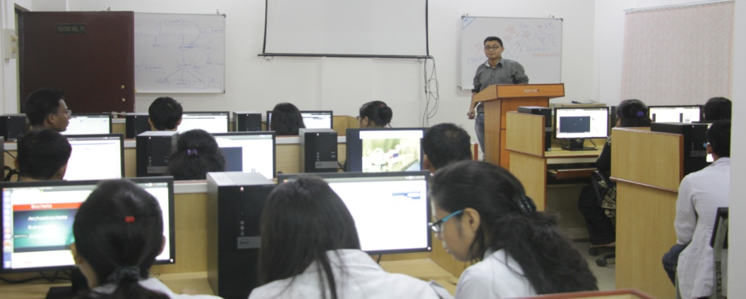
INFRASTRUCTURE DEVELOPED

Slide 14
Thrust Areas of Research
Microbial Biotechnology
Pharmaceutical Biotechnology
Bioinformatics

Slide 15
Microbial Biotechnology

Slide 16
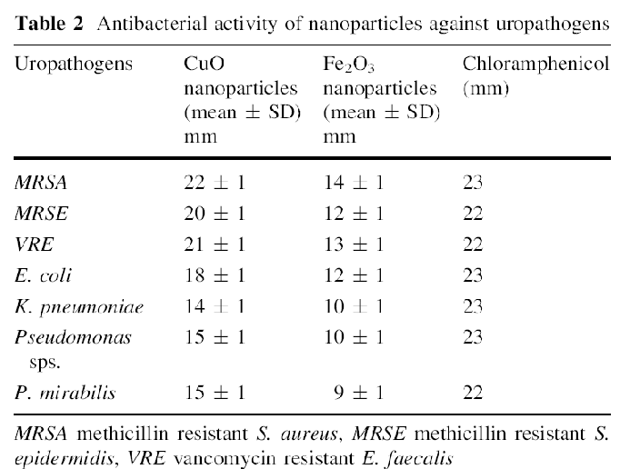
Comparative Study of Antibiofilm Activity of CuO and Fe₂O₃ Nanoparticles Against Multidrug Resistant Biofilm Forming Uropathogens
Antibiofilm assay of CuO and Fe₂O₃ based nanoparticles was evaluated
The CuO nanoparticles displayed maximum antibacterial activity followed by Fe₂O₃ with zone of inhibition against the MDR strains as shown in the table.
Publications:
Agarwala, M., Choudhury, B., and Yadav, RNS (2014): Comparative Study of Antibiofilm Activity of Copper Oxide and Iron Oxide Nanoparticles Against Multidrug Resistant Biofilm Forming Uropathogens Indian J Microbiol. DOI 10.1007/s12088-014-0462-z Impact Factor: 0.457

Slide 17
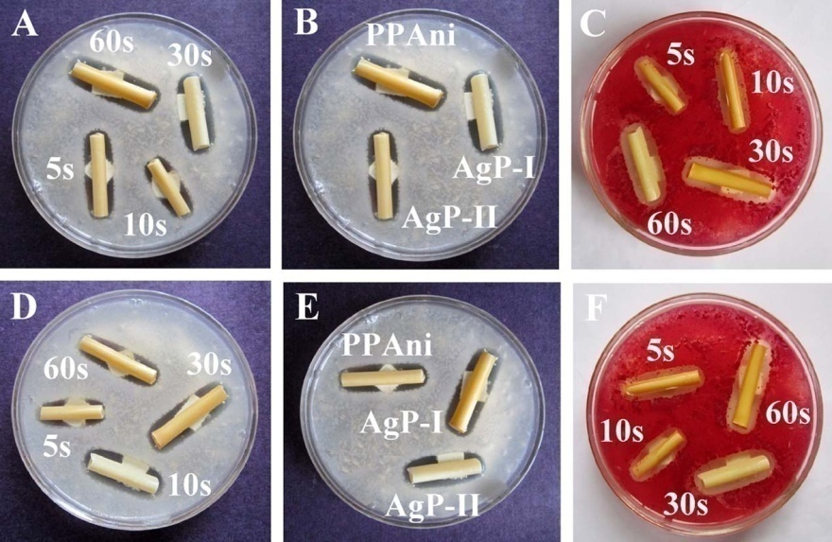
Study of antibiofilm activity of silver–polymer nanocomposite on polymeric medical devices deposited by one step plasma process
Foley’s catheters were coated with Silver (Ag), plasma polymerized aniline (PPAni) and Ag2PPAni composite by plasma-based deposition processes.
Characterized by XRD, EDX, SEM, and FT-IR spectroscopy.
The analysis confirmed the formation of Ag nanoparticles (AgNPs), PPAni and Ag2PPAni composite and also corroborated their successful deposition over the catheters
Bioassays were performed to validate their efficacies to kill planktonic cells as well as to remove biofilm.
Antibacterial activity of Ag, PPAni, and Ag–PPAni composite coated catheters against MRSA (A-C) and E. coli (D-F), respectively. (C)
and (F) were plates of MRSA and E. coli overlaid with p-INT showing living cells as red while dead cells as colourless around zones of inhibition.
Publications:
Agarwala, M., Barman, T., Gogoi, D., Choudhury, B., Pal, A.,R., and Yadav, RNS (2014): Highly effective antibiofilm coating of silver–polymer nanocomposite on polymeric medical devices deposited by one step plasma process; Journal of Biomedical Materials Research B: Applied Biomaterials. DOI: 10.1002/jbm.b.33106 Impact Factor: 2.308

Slide 18
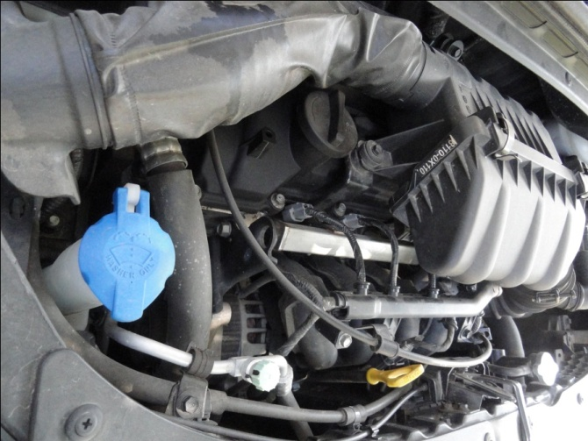
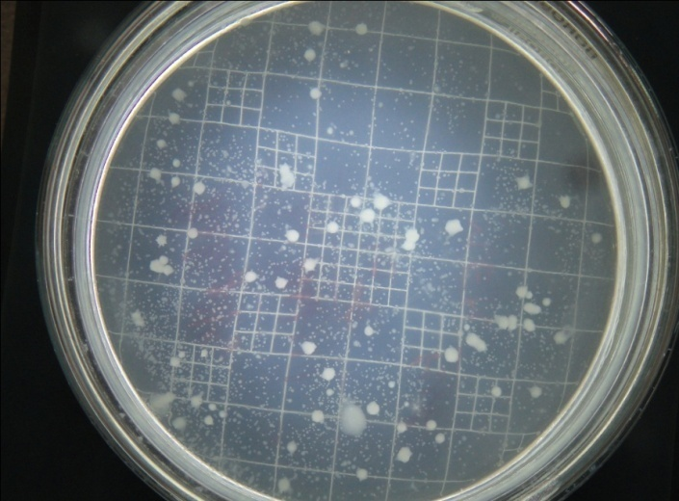
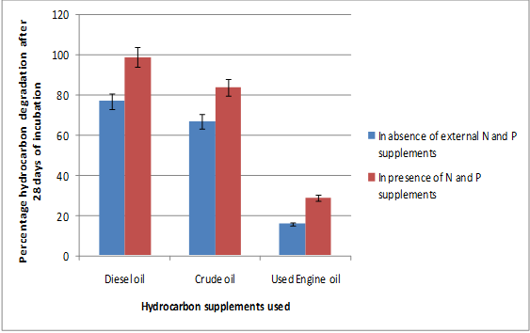
Isolation and Characterization of Stress Tolerant Hydrocarbon Degrading Microorganisms from Various parts of Automobile engine
Hydrocarbon residues from automobile engine
Screening for potential Hydrocarbon degrader
Petroleum Hydrocarbon degradation after 28 days of incubation
Identification and Characterization

Slide 19
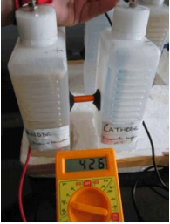
Construction of Double Chambered Microbial fuel Cell (MFC) using household materials
Double chambered microbial fuel cell (MFC) was constructed by using household materials. Plastic jars of 500 ml volume were used for the construction of cathodic and anodic chamber, and were connected using an agar salt bridge (3% KCl agar).
The anodic and cathodic chambers were filled with Basal minimal salt media and 100mM Phosphate buffer (pH 7) respectively.
15cm long carbon electrodes were used in each chamber.
Maximum voltage of 700mV was obtained from 48-100 hr in presence of Bacillus megaterium and yeast supplement.
Fig: The MFC constructed in the lab attached with a
multimeter
Publications:
Borah, D., More, S., and Yadav, RNS (2013): Construction of double chambered microbial fuel cell (MFC) using household materials and Bacillus megaterium isolate from tea garden soil. Debajit Borah, Sejal More and RNS Yadav. The Journal of Microbiology, Biotechnology and Food Sciences. 3(1): 84-86.

Slide 20
Isolation and Characterization of Probiotic Strains from Soil samples of Cattle farm
Characterization of growth pattern in acidic condition
Cattle farm soil
Characterization of growth pattern in presence of Bile salt media
Screening of non pathogenic acid tolerant Probiotic bacteria
Molecular Characterization of the potential isolate
Identification of the potential isolate by 16S rRNA sequencing
Sequence Submitted:
GenBank accession number KJ671867 was obtained for the strain Bacillus cereus DBRDU2

Slide 21
Isolation and Molecular characterization of Metallo β lactamase producing Multidrug Resistant (MDR) bacterial isolates from Hospital wastes
HOSPITAL WASTE
Screening of MDR isolates
Screening of the Metallo β lactamase producing MDR isolate
Plasmid DNA
characterization
Sequence Submitted:
GenBank accession number KJ812198 and
KJ812199 was obtained for the strain Cronobacter sakazakii strain AMD04 and Providencia vermicola strain AMD05 respectively
Identification of the isolate on the basis of 16S rRNA sequencing

Slide 22
LIST OF GENE SEQUENCES DEPOSITED IN NCBI DATABASE
SL. No. | Name of the bacterial strain | Amplified gene | GenBank accession Number | Significant Properties
01 | Bacillus cereus strain DRDU1 | 16S rRNA | KF273330 | Hydrocarbon degrading
02 | Bacillus cereus strain DBRDU2 | 16S rRNA | KJ671867 | Probiotic strain
03 | Enterococcus faecium strain VDR03 | 16S rRNA | KJ698643 | Haemolytic strain
04 | Cronobacter sakazakii strain AMD04 | 16S rRNA | KJ812198 | Metallo beta lactamase producing MDR strain
05 | Providencia vermicola strain AMD05 | 16S rRNA | KJ812199 | Metallo beta lactamase producing MDR strain

Slide 23
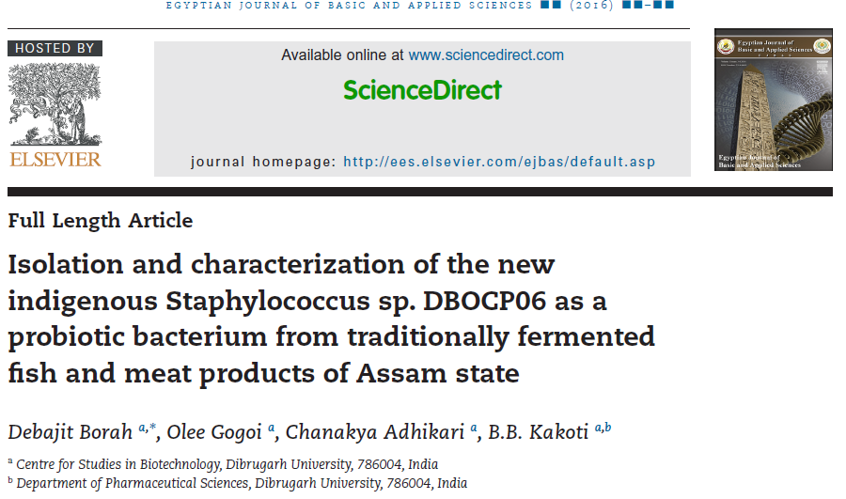
Isolation and characterization of probiotic bacteria from traditionally fermented fish and meat samples of Assam

Slide 24
Pharmaceutical Biotechnology

Slide 25
Objectives
Screening for:
Findings
The selected plants exhibit antimicrobial and antioxidant activities.
The bioactivities are dependent on their phytochemical profiles.
Attempts to isolate and characterize the bio-actives by MS and NMR spectroscopy are in progress.
Phytochemicals
Antimicrobial activity
Antioxidant activity
Bioactivity guided isolation and characterization of bioactive compounds
Evaluation of Antimicrobial and Antioxidant Efficacy of the Selected Plants of the Region
Hydrocotyle rotundifolia
Eryngium foetidum
Centella asiatica
Leucas aspera
Publications:
1. Unni BG, Borah A, Wann SB, Singh HR, Devi B. Phytochemical and Antibacterial Study of Traditional Medicinal Plants of North East India on Escherichia coli . Asian J Exp Sci. 2009;23(1):103–8.
2. Borah A, Narayan R, Yadav S, Unni BG. Antioxidant and free radical scavenging activity of Leucas aspera L. International Journal of Pharmaceutical Sciences Review and Research. 2011;9(2):46–9.

Slide 26
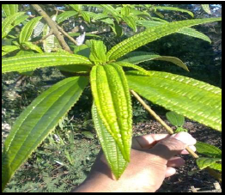
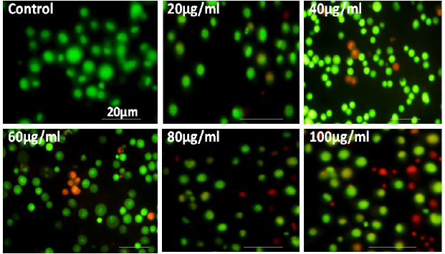
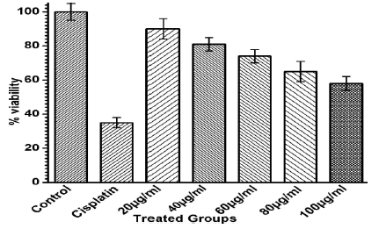
Phytochemical and Cytotoxic properties of wild Sarchoclamys pulcherrima Goud from Assam, India
Fig: A twig of S. pulcherrima Goud
Fig: Floor picture of Apoptosis study using fluorescence microscope (the damaged cells are in orange/ red color and viable DLA cells are shown in green color)
Fig: In-vitro test for short term cytotoxicity of different doses of crude ethanol extract of S. pulcherrima leaves against the Murine Dalton’s Ascites lymphoma cell line.
Publication:
Kardong, D., Verma, AK., Upadhyaya, S., and Borah, D. (2013): Phytochemical and cytotoxic properties of wild Sarchoclamys pulcherrima Goud from Assam, North Eastern India; International journal of pharmacy and pharmaceutical sciences. 5(4): 394-397.
Impact Factor=1.59

Slide 27
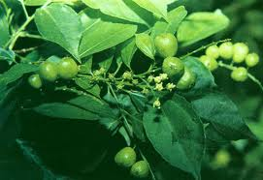
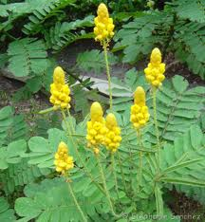
Phytochemical analysis and antibacterial activity of leaf and seed extracts of Cassia alata and Croton tighlium
Fig: Croton tighlium
Fig: Cassia alata
Amount of phytochemicals ( in mg/gm) present in the seed extracts of Cassia alata and Croton tighlium
Antimicrobial activity:
Aqueous extracts of these two plants showed antibacterial activity against Staphyllococcus aureus and Escherichia coli.
Publication:
Iraqui P and Yadav R.N.S. Phytochemical analysis of leaf and seed extracts of Croton tighlium plant; World J of Pharmaceutical Research, 2013, : 112-115
Amount of phytochemicals ( in mg/gm) present in the leaf extracts of Cassia alata and Croton tighlium

Slide 28
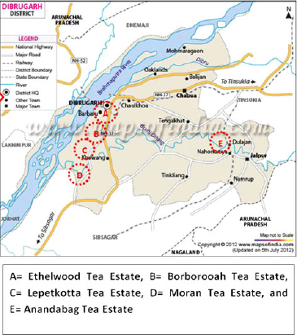
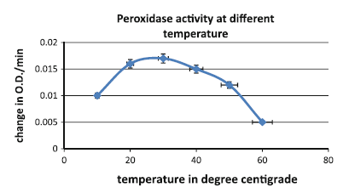
Extraction and characterization of peroxidase from Camellia sinensis
Peroxidase is an oxidative enzyme known to be involved in defence reactions in plants.
Peroxidase enzyme extracted from Camellia sinensis (tea) leaves collected from 5 leading tea estates located in district Dibrugarh of Assam, India was characterized.
Its effect on varying substrate concentration, temperature, pH and salt was studied.
Its activity was found to be inhibited by ethylene-diamine-tetra-acetic acid.
The enzyme was thermostable showing activity up to 60ºC. Its specific activity was 6.19 U/mg protein.
With all the above features, the enzyme peroxidase isolated from Camellia sinensis is proved to be useful for industrial purposes.
Publication:
Borah, D., Shah, S., and Yadav, RNS (2012): Extraction and Characterization of Peroxidase from Camellia sinensis. Proceeding of National Academy of Science (B-Biological Sciences). 84 (2):343-348. DOI 10.1007/s40011-013-0211-9. Published
(Impact Factor=0.02)

Slide 29
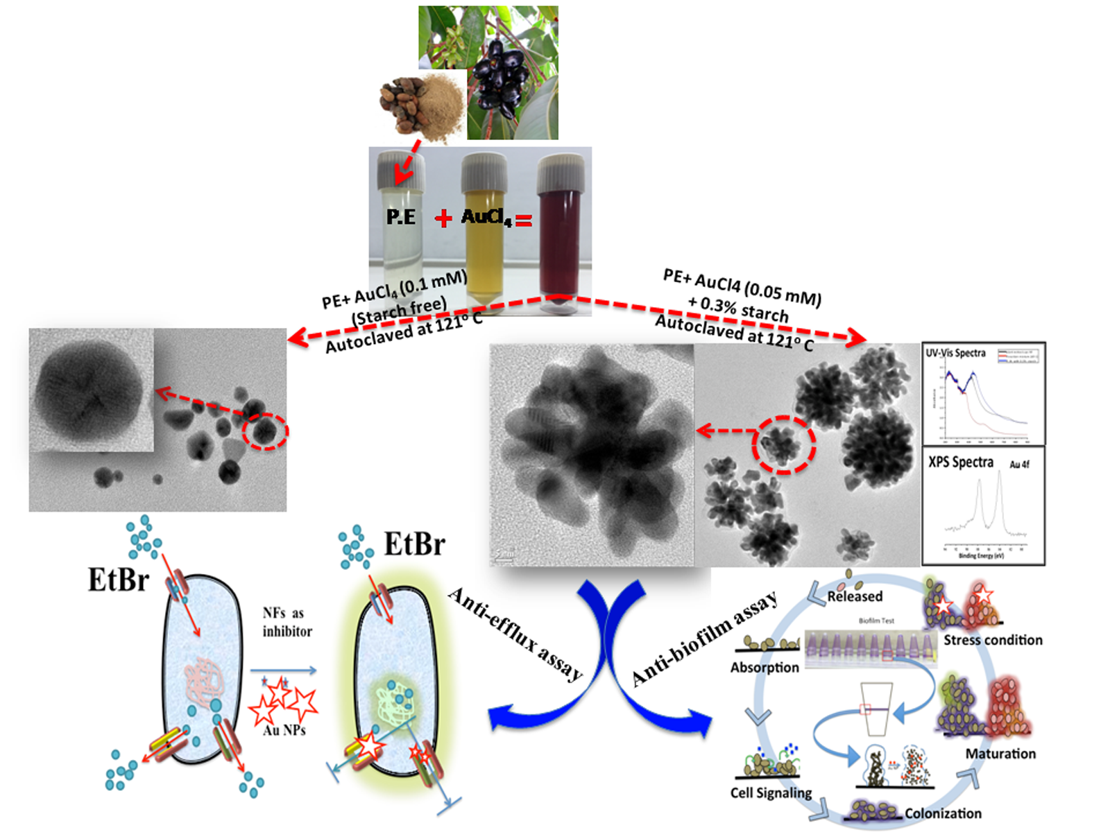
Evaluation of anti-microbial and anti-biofilm activities of Syzygium cumini (L.) Skeels mediated Gold Nanoflowers (Au NFs) against multidrug resistant microbes
Green Synthesis
Future applications
Non cytotoxic
Extensively characterized
Anti-Efflux and Anti biofilm Activity

Slide 30
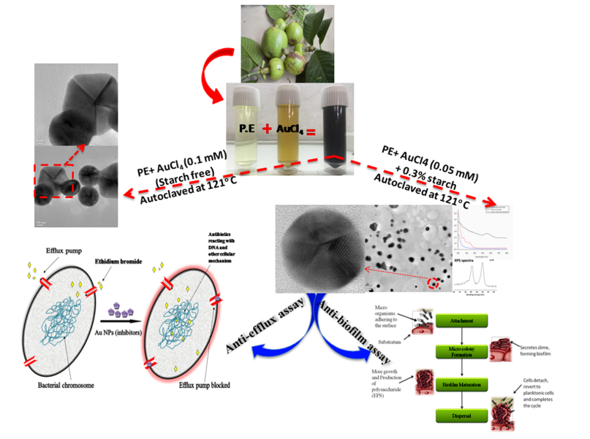
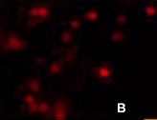
Evaluation of anti-microbial and anti-biofilm activities of Syzygium cumini (L.) Skeels mediated Gold Nanoflowers (Au NFs) against multidrug resistant microbes
Cytotoxicity assay

Slide 31
Biogenic synthesis of palladium nanoparticles and their applications as catalyst and antimicrobial agent

Slide 32
Traditionally used medicinal Plants
in vitro evaluation of anti-diabetic potential of crude extracts and fractions
in vitro evaluation of anti-inflammatory potential of crude extracts and fractions
Green synthesis of silver nanoparticles using plant extracts and evaluation of their antimicrobial, antioxidant and anti-inflammatory activities
Evaluation of antimicrobial activity of plant extracts and Synergism between various plant extracts
Notes:
In addition to the foregoing research, traditionally used medicinal plants are being studied for their various biological activities by standard in vitro methods.

Slide 33
Interaction of XRCC1 and XPD Gene Polymorphisms with Lifestyle and Environmental Factors Regarding Susceptibility to Lung Cancer in a High Incidence Population in North East India
This study aimed to explore the role of XRCC1 (Arg399Gln) and XPD (Lys751Gln) gene polymorphisms, lifestyle and environmental factors as well as their possible interactions in propensity to develop lung cancer in a population with high incidence from North East India.
A total of 272 lung cancer cases and 544 controls were collected and XRCC1 (Arg399Gln) and XPD (Lys751Gln) genotypes were analyzed using a polymerase chain reaction based restriction fragment length polymorphism assay.
The combined Gln/Gln genotype of XRCC1 and XPD genes was significantly associated with increased risk for lung cancer. Interaction of XRCC1Gln/Gln genotype with exposure of wood combustion, exposure of cooking oil fumes and tobacco smoking and, interaction of XPD with betel quid chewing and tobacco smoking were found to be significantly associated with increased risk for lung cancer.
Fig: RFLP Photograph for XRCC1 Genotype. Lane M represents 100 bp DNA Ladder. Lane 6 is characterised by 615bp that represents XRCC1 Gln/Gln genotype. Lane 1, 2, 3, 4, 5, 7, 8, 9, 10, 12, 13, 14 and 15 are characterised by 377bp and 238bp that represents XRCC1 Arg/Arg genotype. While, Lane 11 and 16 are characterised by 615bp, 377bp and 238bp that represents XRCC1 Arg/Gln genotype
Publications:
Saikia, B.J., Phukan, R.K., Sharma, S.K., Sekhon, G.S., Mahanta, J. (2014): Interaction of XRCC1 and XPD Gene Polymorphisms with Lifestyle and Environmental Factors Regarding Susceptibility to Lung Cancer in a High Incidence Population in North East India. Asian Pacific Journal of Cancer Prevention;(15):1993-1999.
Impact factor: 1.2

Slide 34
Bioinformatics

Slide 35
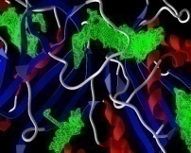
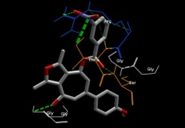
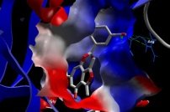
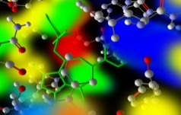
Design and Identification of Novel malaria inhibitor via Laplacian-modified Bayesian based QSAR Modeling, Virtual Screening and Molecular Docking Study
Training Set Compounds
Training set of twenty two naturally occurring highly active antimalarial compounds and their conformers were used to develop an Extended-connectivity fingerprints based Laplacian-modified Bayesian QSAR model.
Study reveals twenty one potential lead molecules as novel anti malarial molecules screened from Chem Bridge database, which exhibit good estimated activities by the QSAR model.
Molecular Docking was carried out with these hits against the cross validated binding sites of wild and mutant Plasmodium falciparum dihydrofolate reductase (pfDHFR) receptor models.
We have identified two compounds (CB7730780 and CB7981022) with favorable interaction at receptor binding sites and least docking score as a potential and efficient antifolate (pfDHFR inhibitor) in comparison with the existing co-crytallized ligands.
Compound Name | Mol Wt | IC50 (µM)
Catechin | 440.356 | 1.20
Catechin 5 gallate | 440.356 | 1.00
Artonin E |  | 4.80
Artocarpones A | 384.379 | 0.12
Artonin A | 502.555 | 0.55
Cycloheterophyllin | 502.555 | 0.02
Artoindonesianin R | 400.422 | 0.66
Heterophyllin | 520.613 | 1.04
Lanaroflavone | 538.458 | 0.48
Ginkgetin | 580.538 | 2.00
Allanxanthone C | 464.55 | 1.30
Symphonin |  | 1.30
Garciniaxanthone | 440.486 | 2.50
4-Nerolidylcatechol |  | 0.67
Isokinikophore | 434.395 | 0.28
Bazouanthrone | 486.642 | 1.8
Tanachin | 264.317 | 1.5
Casearlucin A | 518.639 | 0.62
Casamembrol A |  | 0.57
Laetiaprocerine A |  | 0.58
Bonducellpins C | 420.496 | 0.12
7-acetoxybonducellpin C | 462.533 | 0.6
Proposed Compound from Chem Bridge Database
DOCKING
DRUG LIKE FILTER
QSAR MODEL
Paper under communication..

Slide 36
Comparative modelling of Plasmodium falciparam Dihydropteroate Synthase 2 and docking study against compounds from anti-malarial plant Carcia papaya and Swertia chirata
Homology based Three dimensional (3D) structure Dihydropteroate synthase (DHPS), essential enzyme required for the folate biosynthesis in Plasmodium falciparum was predicted .
The study identified few phytochemical such as Atovquone, Nitroblue tetrazolium, Caffeic Acid and Kaempferol in terms of least docking and optimum ADME scores as a novel DHPS inhibitor.
Compound Name/ ID | HIA (%) | Caco-2 (nm/sec) | MDCK (nm/sec) | Log kp (cm/hour) | PPB(%) | BBB (C.brain/C.blood)
Atovquone | 96.013 | 22.323 | 10.711 | -2.463 | 99.709 | 1.935
Nitroblue tetrazolium | 99.463 | 19.403 | 0.0430 | -2.308 | 100.00 | 0.946
Caffeic Acid | 82.301 | 21.107 | 109.433 | -2.669 | 40.290 | 0.497
Kaempferol | 85.667 | 18.045 | 2.228 | -4.026 | 100.00 | 0.511
P-coumaric acid | 92.095 | 21.109 | 75.059 | -1.707 | 63.055 | 0.694
Kaempferol and Mangiferin as docked posed

Slide 37
Design, virtual screening and docking study of novel NS3 inhibitors by targeting protein-protein interacting sites of dengue virus - a novel approach:
Homology modeling and protein-protein docking study of NS3 with NRBP (Nuclear Receptor Binding Protein) of human as it has been proved that NS3 of DENV interacts with NRBP which causes cellular trafficking in human cell.
65 novel compounds were designed which involved substituting positions 1-5 of the benzyl ring A (4hydroxy-panduratinA) of NRBP with various substituents.
The protein-protein docking showed that the amino-acid residues of NS3 which were interacting with NRBP were found to be Ala 325, Asp 324, Phe 326, Asp 335, Glu 336, Glu 328, Asp 485, Gln 478, Arg 459, Gly 446 and Leu 480.
These residues were targeted by the ligands which showed excellent binding affinity as binding energy. The ligand PKP10 showed lowest binding energy. It is also observed that the interface residues participated in the protein-protein interaction are being inhibited by the ligands.
ISI Impact factor: 2.69, 2012 Current Pharmaceutical Biotechnology

Slide 38
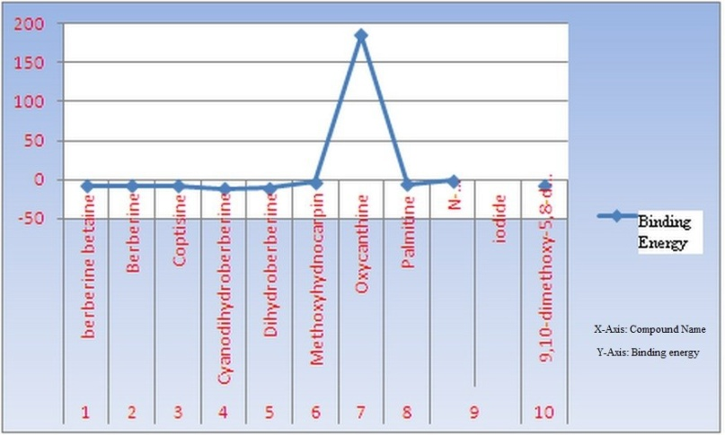
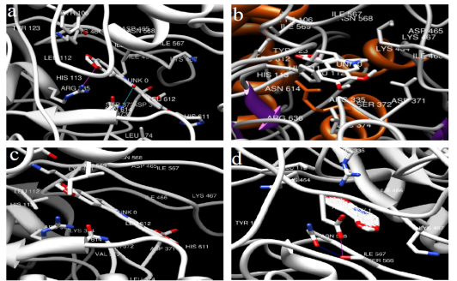
Homology modeling and docking studies of Plasmodium falciparum telomerase reverse transcriptase with berberine and some of its derivatives
A three-dimensional structural model of PfTERT was constructed using multiple sequence alignment and homology modeling procedures, followed by extensive molecular dynamics calculations.
The analogues of berberine were successfully docked into the binding pocket of the protein. The hydrogen bonds were analyzed along with the binding energy was observed. The binding energy were found to be -8.36, -8.36, -8.23, - 11.34, -10.51, -3.56, +186.20, -5.99, -1.10 and -7.48 in Kcal/mol with reference drugs.
The least binding energy was found to be -11.34 Kcal/mol which determines that the most effective analogue. As a result this can be used as antiplasmodial drug.
Interaction

Slide 39
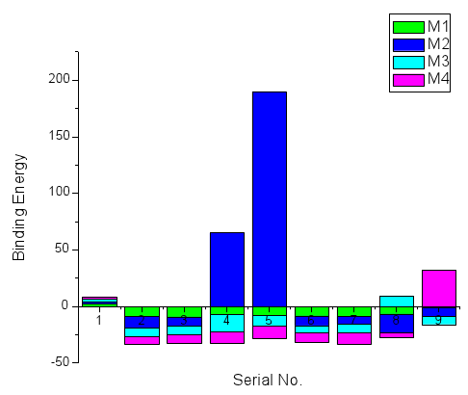
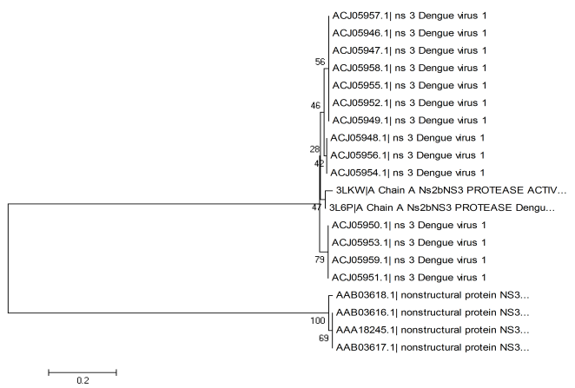
In silico antigenic site evaluation and antiviral therapy against dengue serotypes
The aim of the present study is to block the replication of the virus by targeting the NS3 Protein. The retrieved sequences of NS3 protein from NCBI shows that the antigenic sites of the protein are highly variable in all the four serotypes of dengue virus (DENV) i.e. DENV I, DENV II, DENV III and DENV IV.
DENV III found to be most distantly related serotype among all the serotypes studied using UPGMA method.
The 3D structure of NS3 protein was modeled using homology modeling by MODELLER 9v8. Evaluation of the constructed NS3 protein models were done by PROCHECK, WhatIf using Exome Horizon.
The derived compounds of mycophenolic acid and ribavirin were docked as ligands to the constructed models of NS3 protein using Autodock 4.2 for Protein-ligand interaction study.
Binding Enegry Analysis From the interaction study of the ligands it was observed that the ligands 3, 8, 4 and 5 are the best inhibitors for DEN-I, DEN-II, DEN-III and DEN-IV respectively. These ligands showed the binding energy of -9.18, -16.52, - 15.87 and -10.66 Kcal/mol respectively for the corresponding serotypes.
Phylogenetic analysis of DENV I

Slide 40
An in silico Approach for Identification of antimycobacterial compounds

Slide 41
Achievements
Debajit Borah
Assistant Professor
"The IRES Excellent Paper award" for oral presentation in the "25th International Conferences on Engineering and Natural Sciences" held in Pattaya, Thailand on 31st January, 2016.
Young Scientist Award for oral presentation in the 1st International Conference on “New Horizons in Pharmaceutical and Biomedical Sciences” (Jan 12-13, 2013), organised by Sheetal Life Sciences (P) Ltd., Dehradun and sponsored by the Govt. of Uttarakhand.

Slide 42
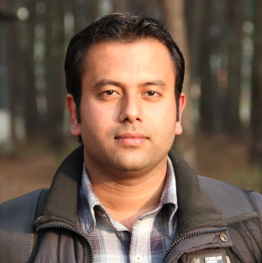
Achievements
Dr. Kaushal Sood
Assistant Professor
Received Best Paper Certificate for paper entitled- “Effect of solvent on the extraction of antioxidant and antimicrobial components from Eryngium foetidum L. “ from International Journal of Medicine and Pharmaceutical Sciences

Slide 43
List of publications from the Centre for Biotechnology & Bioinformatics, Dibrugarh University
Discrepancy among the synonymous codons with respect to their selection as optimal codon in bacteria; Siddhartha Sankar Satapathy; Bhesh Raj Powdel; Alak Kumar Buragohain; Suvendra Kumar Ray; DNA Res (2016); doi: 10.1093/dnares/dsw027; July 17, 2016
Chaliha, A.K., Gogoi, D., Sarma, D., Chetia, P., Buragohain, A. K. 2015. An In Silico Approach for Identification of Potential Anti-Mycobacterial Targets of Vasicine and Related Chemical Compounds. Combinatorial Chemistry & High Throughput Screening, Bentham Science. 19(1): 14-24.
Borah, D., Yadav, RNS (2016): Bioremediation of petroleum based contaminants with biosurfactant produced by a newly isolated petroleum oil degrading bacterial strain; Egyptian Journal of Petroleum (in press). http://dx.doi.org/10.1016/j.ejpe.2016.02.005
Borah, D., Singh, V., Rahman, A., Gogoi, B., and Hazarika, M. (2016): Prevalence of Multidrug Resistant (MDR) Novel Enterococcus faecium Strain VDR03 in Broiler Chicken Meat Samples Collected from Dibrugarh Town, Assam (India); Research Journal of Microbiology. DOI: 10.3923/jm.2016. (In Press)
Borah, D., Gogoi, D., Yadav, A.K., and Gogoi, M. (2015): Improper handling of harmful chemicals by small tea growers of Assam: Challenge to heath and local environment; Journal of Commercial Biotechnology.21(2):8-9. DOI: 10.5912/jcb702.
Borah, D., Singh, V., Chaliha, A.K., Gogoi, D., and Mohamedkassm, N. (2014): New Ebola vaccine trial starts in humans – but how safe is it? Current science. 01/2015; 108(1):10.
Borah, D., Gogoi, B., and Gogoi, D. (2014): NASA Honors Indian Village entrepreneur and Inventor UdhabBharali with 98 innovations; Current Science. 107(5):941.
Borah, D., and Yadav, RNS (2015): Plasmid Curing of a Novel Hydrocarbon Degrading Bacillus cereus Strain DRDU1 Revealed its Involvement in Petroleum Oil Degradation; J Pet Environ Biotechnol 6 (3):220. doi: 10.4172/2157-7463.1000220.
Borah, D., Gogoi, D., and Yadav, RNS (2015): Computer aided Screening, Docking and ADME study of Mushroom derived Compounds as Mdm2 inhibitor, a novel approach; National Academy Science Letters. 38(6):469-473.
Borah, D., and Yadav, A.K. (2015): A Novel ‘Green’ Synthesis of Antimicrobial Silver Nanoparticles (AgNPs) by using Garciniamorella (Gaertn) Desr. Fruit Extract; Nanoscience and Nanotechnology Asia, 5(3): 25-31.
Borah, D., and Yadav, R.N.S. (2014): Optimization of BH medium for Efficient Biodegradation of diesel, crude oil, and used engine oil by a newly isolated Bacillus cereus strain DRDU1 from an automobile engine; Biotechnology. 13(5): 181-185. DOI 10.3923/biotech2014.181.185.
Borah, D., Chaliha, A.K., Gogoi, D., and Yadav, RNS (2014): GM tea: the need of the hour to reclaim India’s leading position in the global tea market; Journal of Commercial Biotechnology. 20(3): 9-11.
Borah, D., Shah, S., and Yadav, RNS (2014): Extraction and Characterization of Peroxidase from Camellia sinensis. Proceeding of National Academy of Science (B-Biological Sciences). 84 (2):343-348. DOI 10.1007/s40011-013-0211-9. Published by Springer, USA.
Borah, D., Shivasharanappa, K., Hanchinalmath, J.V., Sundeep, Y.S., and Talluri, V.S.S.L.P. (2014): Optimization and production of Alkaline Proteases from Agro byproducts using a novel TrichodermaViridiae strain VPG 12, isolated from agro soil; International Letters of Natural Sciences. 9:78-84.
Borah, D., and Yadav, RNS (2014): Biodegradation of petroleum oil by a novel Bacillus cereus strain DRDU1 from an automobile engine; International Journal of Environmental Research. 8(4):1287-1294.
Borah, D. (2014): MRSA: A super Germ. A Book Chapter in Science Galaxy. Published by Golden Jubilee Celebration Committee, Dibru College, Dibrugarh (Assam), in collaboration with KaustubhPrakashan, Dibrugarh-01 (Assam). ISBN-978-93-82283-67-6.

Slide 44
Borah, D.,Gogoi, D., and Yadav, RNS (2014): Man of Honour: JadavPayeng; The Forest Man of India; Current Science. Vol. 106(4):499.
Borah, D., and Yadav, RNS (2014): Biodegradation of diesel, crude oil, kerosene and used engine oilby a newly isolated Bacillus cereus strain DRDU1 from an automobile engine in liquid culture; Arabian Journal of Science and Engineering. 39(7):5337–5345. DOI 10.1007/s13369-014-1118-3.
Kardong, D., Verma, AK.,Upadhyaya, S., and Borah, D (2013): Phytochemical and cytotoxic properties of wild SarchoclamyspulcherrimaGoud from Assam, North Eastern India; International journal of pharmacy and pharmaceutical sciences. 5(4): 394-397.
Borah, D., Deka, P., Bhattacharjee, P., Changmai, A., and Yadav, RNS (2013): Ocimum sanctum mediated silver nano particles showed better antimicrobial activities compared to citrate stabilized silver nano particles against multidrug resistant bacteria. Journal of Pharmacy Research. 7(6): 478-482. DOI: 10.1016/j.jopr.2013.06.018.
Borah, D., More, S., and Yadav, RNS (2013): Construction of double chambered microbial fuel cell (MFC) using household materials and bacillus megaterium isolate from tea garden soil. Debajit Borah, Sejal More and RNS Yadav. The Journal of Microbiology, Biotechnology and Food Sciences. 3(1): 84-86. Published by Faculty of Biotechnology and Food Sciences, Nitra, Slovakia.
Borah, D., Iraqui, P., Kardong, D., and Yadav, RNS (2013): Qualitative and Quantitativescreening of Phytochemicals of Meliosommapinnata (Dermi), a forest based vegetable plant traditionally used by Mising community of Assam, India. International journal of pharmacy and pharmaceutical sciences. 5(2):200-203.
Borah, D., Kumar, T., and Mishra, V (2012): Process optimization, partial purification and characterization of protease enzyme from Bacillus altitudinis (MCCB-0014). International journal of pharmacy and pharmaceutical sciences. 4(3):483-89.
Borah, D., Yadav, RNS, Sangra, A., Shahin, L., Chaubey, AK (2012): Production, purification and characterization of nattokinase from Bacillus subtilis, isolated from tea garden soil samples of Dibrugarh, Assam; Asian journal of pharmaceutical and clinical research. 5(3):124-25, 2012.
Borah, D., Yadav, RNS, Sangra, A., Shahin, L., Chaubey, AK (2012): Production, Purification and Process optimization of Asparaginase (an anticancer enzyme) from E. coli, isolated from sewage water; International journal of pharmacy and pharmaceutical sciences. 4(4):560-63.
Borah, D., and Yadav, RNS (2012): UV Treatment Increases Hydrocarbon Degrading Potential of Bacillusspp. Isolated from Automobile Engines; American-Eurasian J. Agric. & Environ. Sci. 12 (6): 760-63. DOI: 10.5829/idosi.aejaes.2012.12.06.6246. (IDOSI, UAE)
Borah, D., Buragohain, P., Saikia, A., and Yadav, RNS (2012): Synthesis and Evaluation of Antimicrobial SilverNanoparticles on Multidrug-Resistant Bacterial Isolatesfrom Urine Samples of Diabetic Patients and InfectedHuman Soft Tissues; BioNanoScience. 2(4):322-328. DOI 10.1007/s12668-012-0053-6.
Borah, D., Parida, P., and Kumar, T (2012): Paper Currencies, a potential carrier of pathogenic microorganisms; International Journal of Applied Biology and Pharmaceutical Research. 3(1):23-25.

Slide 45
Borah, D (2011): Isolation and molecular characterization of hydrocarbon degrading microorganisms isolated from automobile engines; Developmental Microbiology and Molecular Biology. 2(1):23-28.
Borah, D., Chaudhary, VK (2011): Isolation and molecular characterization of hydrocarbon degrading microorganisms from tannery effluent; International Journal of Plant, Animal and Environmental Sciences. 1(2):110-14.
Borah, D., Solanki, V., and Mishra, V (2011): Protein and molecular characterization of Clostridium spp.isolated from contaminated food and soil samples; International Journal of Applied Biology and Pharmaceutical Research. 2(3):189-93.
Borah, D., and Mishra, V (2011): Phytochemical and antimicrobial effects of some indigenous medicinal plants; International Journal of Plant, Animal and Enironmental Sciences. 1(1):71-73.
Borah, D., and Mishra, V (2011): Production of Biofuel from fruit wastes; International Journal of Advanced Biotechnology Research. 1(1):71-74.
Dibya Jyoti Hazarika and K. Sood (2015). In vitro antibacterial activity of peptides isolated from Areca catechu Linn. Der Pharmacia Lettre. 7(1):1-7. ISSN 0975-5071.
M. Borkataky and K. Sood. (2014). Antibacterial, Antioxidant and cytotoxic activities of CinnamomumtamalaNees. Leaves. International Journal of Medicine and Pharmaceutical Sciences. 4 (6): 55-62. ISSN (Print): 2250-0049; E-ISSN: 2321-0095.
R. Hazarika, K. Sood, B. Neog (2014). Capsaicinoid: A potential antioxidant with close interactions against human iNOS in docking study.South Asian Journal of Experimental Biology. 4 (4): 207-214. ISSN: 2230-9799.
K. Sood and R.N.S. Yadav (2014). Effect of solvent on the extraction of antioxidant and antimicrobial components from Eryngiumfoetidum L. International Journal of Medicine and Pharmaceutical Sciences. 4 (5): 31-40.
K. Sood and R.N.S. Yadav (2014). Phytochemical screening and antimicrobial activity of four members of family Apiaceae. International Journal of Phytomedicine. 6 (2).
P. Dutta, P. Dutta, A.K. Rai, K. Neog, R. N.S. Yadav and K. Sood (2014). Effect of hormones (JH-III AND 20E) on biochemical and ultrastructure aspects of Muga silk worm Antheraeaassamensis (Lapidoptera: Saturniidae). International Journal of Recent Biotechnology, 2 (1): 11-23.
D. Kardong, K. Deori, K. Sood, R. N. S. Yadav, T. C. Bora and B. K. Gogoi (2012). Evaluation of nutritional and biochemical aspects of Po:roapong (Saimod)- A homemade alcoholic rice beverage of Mising tribe of Assam, India. Indian Journal of Traditional Knowledge, 11(3): 499-504.
M. Borkataky, K. Sood, D. Kardong, B. B. Kakoti and L. R. Saikia (2011). Antibacterial Activity and Phytochemical Analysis of Two Folklore Medicinal Plants of North-East India. Bulletin of Life Sciences. XVII: 73-80.
D. Kardong, K. Sood, R. N. S. Yadav and T. C. Bora (2011). Amylolytic activity of mold isolated from epop used by Mising tribe of Assam, India in preparation of alcoholic rice beer. Bulletin of Life Sciences, XVII: 92- 101.
D. Kardong, A. K. Verma, P. Gogoi, S. Singh, K. Gogoi, G. Bora and K. Sood (2009). Endosulfan induced behavioral and biochemical changes in air-breathing fresh water Teleost (C. orientalis) in tea garden localities of Upper Assam. Bulletin of Life Sciences, XV: 83- 93.

Slide 46
Johari S, Kanu M . A Novel Epitope Prediction for Vaccine Designing Against Ebola Viral Envelope Proteins 2015, Indian Journal of Pharmacology 47:7; 13-57.pp
Sinha S, Dias M, Johari S. Molecular Docking of Phytochemicals of Adhatoda vasica with the potential drug targets of Asthma–An Ayurinformatics Approach. Journal of Science. 2016 Mar 31;1(3):12-20. pp .
Chakraborty S, Buragohain J, Johari S, Sinha S. Rational Drug Design For Identifying Novel Target Inhibitors for Tuberculosis with Components of Asparagus racemosus. Journal of Science. 2015 Sep 11;1(2):23-31.
Pegu R, Sarma BP, Borua R, Sinha S, Johari S, Ghosh A. Virtual Screening and Molecular Docking studies for discovery of potent drug candidates among compounds of Adhatoda vasica against Bronchial Asthma. In indian journal of pharmacology 2014 Dec 1 (vol. 46, pp. S37-s37). B-9, kanara business centre, off link rd, Ghaktopar-e, Mumbai, 400075, India: Medknow Publications & Media Pvt ltd.
MRSA-A SUPERBUG Surabhi Johari, Mridujuna Gogoi et al., World Journal of Pharmaceutical Research 4(8):470-492 · July 2015
Virtual Screening and Molecular Docking studies for discovery of potent drug candidates among compounds of Adhatoda vasica against Bronchial Asthma Rigom Pegu, Bishnu Prasad Sarma, Rupali Borua,Subrata Sinha, Surabhi Johari, Arabinda Ghosh Indian Journal of Pharmacology 12/2014; 46(Suppl):S37.
”Exploring the possible mechanism of Albizzia lebbeck components binding with drug targets of Bronchial Asthma –An insilico and Clinical Analysis. Mukamchem Yim, Subrata Sinha, Surabhi Johari et al”IJPSR Vol. 5, Issue 11; November, 2014. (Impact Factor 2.44).
3D QSAR and Docking Studies of a Series of Hamamelitannin Derivatives As Potential PBP4 Inhibitors .Rupanjali Bhattacharjya Sharma, Mridujuna Gogoi, Banasri Baishya, Surabhi Johari
Sinha S, Nath PP, Hazarika GC; Multi Core Aware Java Library for Computing Protein Stability Indices – A Performance Improvement and Power Consumption Study; Procedia Computer Science Elsevier 2015; 70(C):715-722 DOI: 10.1016/j.procs.2015.10.109 ( Impact Factor 0.7 )
Sinha S, Medhi SP, Hazarika GC; Design and Development of Grid Enabled, GP2U Accelerated Java Application (Protein Sequence Study) for Grid Performance Analysis; Procedia Computer Science Elsevier 2015; 70(C):769-777 DOI: 10.1016/j.procs.2015.10.116 ( Impact Factor 0.7 )
Sinha S, Dietary Protein Scoring (DPS) Algorithm for Grading of Food in Vital for Major Function of Human Body - A Computational Biology Approach; Journal of Science 2015; 1(1): 16-24
Chakraborty S, Buragohain J, Johari S, Sinha S. Rational Drug Design For Identifying Novel Target Inhibitors for Tuberculosis with Components of Asparagus racemosus; Journal of Science 2015; Vol 1(2):23-31
Sinha S, Role of Bioinformatics in Climate Change Studies. Journal of Science 2015; 1(1):1-9
Sinha S, Dietary Protein Scoring (DPS) Algorithm for Grading of Food in Vital for Major Function of Human Body - A Computational Biology Approach; Journal of Science 2015; 1(1) : 16-24

Slide 47
Rigom Pegu, Sarma BP, Borua R, Sinha S, Johari S, Ghosh A; Evaluation of the Clinical Effect of Poly Herbal Compound in the Management of (Bronchial Asthma) Tamakaswasa and Study the Vasaka (Adhatoda Vasica Nees) in Silico Approach[Abstract-IND-16]; Indian Journal of Pharmachology 2015; Vol 47(7):57-177 (SCI-Expanded IF: 0.69)
Johari S , Sinha S, Khati RS, Sharma A, Ghosh A, Sarma BP; A Novel In silico Study of Kidney Stone Formulations Found in Shusruta Samhita: An Inception of Ayurinformatics[Abstract-AUT-2];Indian Journal of Pharmachology 2015; Vol 47(7):57-177 (SCI-Expanded IF: 0.69)
Medhi SP, Sinha S, Singh YJ, Singh J(2014). A Competence Based Load Balancing Algorithm for HPC Enabled Bioinformatics Application", Proceedings of International Conference on Communication and Computing, June 12-14 2014, Elsevier Science and Technology Publications p. 372-378
Pegu R, Sarma BP, Borua R, Sinha S, Johari S , Ghosh A; Virtual Screening and Molecular Docking studies for discovery of potent drug candidates among compounds of Adhatoda vasica against Bronchial Asthma; Indian Journal of Pharmacology , December 2014 , Vol 46(Supplement):S37
Jana C, Chaturvedi I, Robine O, Sinha S, Nigam A, Sharma A ; Finding Natural Inhibitor for NS3 Protease Enzyme from Dengue Virus via Molecular Modeling; International Journal of Basic and Applied Biology 2014; 2(3): 124-129
Yim M, Sarma BP, Sinha S, Deka H, Deka H, Parida P, Ghosh A and Johari S. Exploring the Possible Mechanism of Albizzia Lebbeck Components Binding With Drug Targets of Bronchial Asthma –An Insilico and Clinical Analysis. Int J Pharm Sci Res 2014; 5(11): 5040-495 (Impact Factor: 2.42)
Deka HJ, Johari S, Sinha S, Molecular Interaction Studies of the Ligands found in Selaginella moellendroffi with EGFR - a CADD Approach in Search of Drugs for Non-Small Cell Lung Cancer, Interdisciplinary Approach to Biological Sciences Research and Sustainable Development, Department of Botany, Bahona College 2014, p. 299-314
Sinha S, Das PS, Chakraborty S, Dutta P, Deori BP. An open source library for Anesthesia - A package under Medi Java", Proceedings of IEEE Indian Conference on Medical Informatics and Telemedicine (ICMIT), 28-30 March, 2013 , IIT Kharagpur, p.33-38
Johari S, Dey P, Sharma A, Sinha S, Narain K, Barua NC. Flux Balance Analysis: An In Silico Analysis Of Staphylococcus aureus Cell Wall Biosynthesis Pathway Metabolism, Proceedings of International Conference on Machine Intelligence and Research Advancement (ICMIRA), SMVDU, KATRA, 21-23 December 2013, p. 635-640
Yim M , Sarma BP, Johari S , Sinha S , Deka H , Deka H , Sarma J ; Ligand binding studies of identified target protein responsible for Tamaka Swasa (bronchial asthma) with compounds of Shirish - an In Silico Approach; Journal of Ayurveda and Integrative Medicine 2013; 4 (5) (Supplement):13
Sinha S. Core temperature depends on the processing load of the core and the temperature of adjacent core-A Regression Analysis. Communications in Computer and Information Science Springer 2012; 269: 44–50
Chakraborty S, Sinha S, Johari S , Dutta P, Design and Development of Software for managing data for Protein-Ligand Docking Studies, International Journal of Science and Applied Information Technology 2012; 1(1) : 25-29
Sinha S, Das PS, Chakraborty S, Dutta P, Deori BP, Inception of Medi Java: An Open Source Library for Medical Science. International Journal of Applied Information Systems 2012 3(2):38-44
Sinha S, Johari S, Gupta K, Bora S. Protein ligand interaction studies of DJ-1 protein responsible for Parkinson’s disease and chemical analogues of Bacopa monnieri (Brahmi) compounds. Communications in Computer and Information Science Springer 2012; 269: 44–50

Slide 48
Design and Development of Software for managing data for Protein-Ligand Docking Studies.Supriya Chakraborty, Subrata Sinha, Surabhi Johari , Pallavi Dutta, International Journal of Johari S, Sinha S, Bora S, Biswas S, Gupta K. Ligand binding studies of Caspase 3 protein with compounds of Bacopa monneri - A target protein responsible for Alzheimer's disease (AD). Communications in Computer and Information Science 269 Springer 2012; 269: 37-43
Garden rue inhibits the arachidonic acid pathway, scavenges free radicals, and elevates FRAP: role in inflammation; MS Kataki, BB Kakoti, B Bhuyan, A Rajkumari, P Rajak; Chinese journal of natural medicines 12 (3), 172-179 “.” IJPPS; 6: 6, 2014 pp. 558-562 .Elesevier (Impact Factor 1.59)
Pharmacophore Modeling, Virtual Screening And Molecular Docking Studies For Discovery Of Novel Inhibitors Against Staphylococcal Infections . Surabhi Johari, Panchamita Basumatary, Kanwar Narain, Pratap Parida, N.C.Barua, Ligand-Based,International Conference On Machine Intelligence Research And Advancement, IEEE 2013, ISSN: 978-0-7695-5013-8 ,Pp. 628-634.
Flux Balance Analysis: An Insilico Analysis Of Staphylococcus aureus Cell Wall Biosynthesis Pathway Metabolism .Surabhi Johari ,Priyanka Dey Ashwani Sharma, Subrata Sinha Kanwar Narain N.C.Barua, International Conference On Machine Intelligence Research And Advancement, IEEE 2013, ISSN: 978-0-7695-5013-8 ,Pp. 635-640 IEEE Best Paper. Science and Applied Information Technology, (1) 2012, ISSN 2278 – 3083, p 25-29(Citations 1)
Protein ligand interaction studies of DJ-1 protein responsible for Parkinson’s disease and chemical analogues of Bacopa monnieri (Brahmi) compounds .Subrata Sinha , Surabhi Johari, Khushboo Gupta ,Sewali Bora published in ObCom 2011 CCIS 269,pp 44-50 2012 @ Springer-Verlag Berlin Heidelberg. (Impact factor 0.3)
Ligand binding studies of Caspase 3 protein with compounds of Bacopa monneri -A target protein responsible for Alzheimer's Disease (AD) Surabhi Johari, Subrata Sinha , Sewali Bora ,Sagarika Biswas Khushboo Gupta published in ObCom 2011 CCIS 269,pp 37-43 2012 @ Springer-Verlag Berlin Heidelberg .Impact factor 0.3
Ligand Binding Studies for DPP IV a Target Protein Responsible for Diabetes Mellitus Type 2: Structural Based Approach for Drug Designing –“¹Surabhi Johari ,Rajeev Sharmah ,Subrata Sinha “ published in IEEE Explorer ISBN No. 978-1-4244-9579-5 :148-152,2011 . (Citations 17)
“Homology based 3D structure modeling of glucose specific Sesbania stem lectin “- Surabhi Saxena, H.R.Das, Das D, Sagarika Biswas published in “Online Journal of Bioinformatics”Volume 9 (2):113-120, 2008
Sinha S, Hazarika A, Bora B, Hazarika GC. A Comprehensive Study on Grid Performance Enhancement and Server Fault Penalty Minimization on JPPF Grid for E.coli Genome Sequence Alignment Problem. Journal of Science 2016; 1(3):28-33
Sinha S, Dias M, Johari S. Molecular Docking of Phytochemicals of Adhatoda vasica with the potential drug targets of Asthma – An Ayurinformatics Approach. Journal of Science 2016; 1(3):12-20
Sinha S, Bora B, Hazarika GC; Development of a Java Library for Protein Stability and Disorder Computations; Procedia Computer Science Elsevier 2015; 70(C): 265-273 DOI: 10.1016/ j.procs.2015.10.086 ( Impact Factor 0.7 ) 6; 2014

Slide 49
Kalita PP, Das R, Das DJ, Sinha S, Neog B. Design and Development of A Software for Medicinal Plant Database, Journal of Computational Intelligence and Bioinformatics 2011; 4(1):111-118
Sinha S, Kalita PP, Das R. Design of a Reusable Software Component for Finding Restriction Enzyme Site. Journal of Computational Intelligence in Bioinformatics 2011; 4(3): 267-272
Sinha S, Johari S, Sarmah R. An Extensive study on entities and relationships of Cell Line Database (CLDB)-proposed remodeled schema, Bull. Of Life Sciences 2010, Vol. XVI (1-10): 85-91
Sinha S, Chakraborty S, Barman MP, Sahu A. A Study on the performance of serial code on Shared Memory Parallel Architecture. Proceedings of IEEE International Conference on Parallel Distributed and Grid Computing, Oct 28-30, 2010. p 19-22
Sinha S. Overall Operation of DNA Computers with Emphasis on Memory Operations, Proceedings of International Conference of Advanced Computing Technology GRIET, Hyderabad 26-27th December 2008, p. 544-549
Virk,S.S., Baruah, V.J., and Goswami, P. (2013). Giant vesicles as encapsulating matrix for stabilizing alcohol oxidase and as container for coupled enzymatic reactions. Artif. Cell. Nanomed. B. 41(4):255-8. doi: 10.3109/10731199.2012.731413.
Barman, A., Baruah, V.J., and Ray. S.K. (2013). A critical insight into the double strand break repair model of homologous recombination. Ind. J. Fund. Appl Life Sci. 3, 233-236.
Ray S.K., Baruah, V.J., Satapathy, S.S., and Banerjee, R. (2014). Co-translational protein folding is revealing the selective use of synonymous codons along the coding sequence of a low expression gene. J. Genet. 93(3):613-7
Baruah, V.J., Satapathy, S.S, Powdel, B.R., Konwarh, R., Buragohain, A.K., Ray S.K. (2015). Comparative analysis of codon usage in Crenarchaean and Euryarchean genome reveals differential preference of synonymous codons to encode ribosomal and RNA polymerase proteins. J. Genet (accepted)
Sarmah, P., Baruah,V.J., Nath, J., Sarma, R.N., Kurian, B., Hemanthkumar, A.S., Sabu, K.K. (2016). ISSR and SSR markers reveal sex-specific DNA sequences in three Calamus species from India. Agrofor. Syst. doi:10.1007/s10457-016-9952-9
Isolation and characterization of the new indigenous Staphylococcus sp. DBOCP06 as a probiotic bacterium from traditionally fermented fish and meat products of Assam state; D Borah, O Gogoi, C Adhikari, BB Kakoti;Egyptian Journal of Basic and Applied Sciences 3 (3), 232-240;2016
Evaluation of anti-inflammatory activity of Helicia nilagirica Bedd. on cotton pellet-induced granuloma in rats; P Lalawmpuii, C Malsawmtluangi, R Vanlalruata, BB Kakoti; International Journal of Pharmacy and Pharmaceutical Sciences 8 (7); 2016
In-vitro antioxidative potential of methanolic aerial extracts from three ethnomedicinal plants of Assam: A Comparative Study; K Mahato, BB Kakoti, S Borah, M KumarJournal of Applied Pharmaceutical Science Vol 5 (12), 111-116: 2015
Women’s Ginseng (Angelica sinensis): An Ethnopharmacological Dossier; MS Kataki, BB Kakoti; Current Traditional Medicine 1 (1), 26-40; 2015
Pharmacognostic and preliminary phytochemical studies on shoot of Calamus leptospadix Griff.-An ethnomedicinal plant of Assam; S Borah, BB Kakoti, K Mahato, D Chakraborty, S Lahkar, B Gogoi; Indian Journal of Natural Products and Resources (IJNPR)[Formerly Natural ; 2015
Resveratrol and Omega-3 Fatty Acid: Its Implications in Cardiovascular Diseases; BB Kakoti, DG Hernandez-Ontiveros, MS Kataki, K Shah, Y Pathak; Frontiers in Cardiovascular Medicine 2-3; 2015
Evaluation of in-vitro anthelmintic activity of Heliotropium indicum Linn. leaves in Indian adult earthworm; K Mahato, BB Kakoti, S Borah, M Kumar; Asian Pacific Journal of Tropical Disease 4, S259-S262;5; 2014

Slide 50
Anti-arthritic potential of leaves of Lasia spinosa thwaites-an ethnomedicinal plant of Assam in complete freund's adjuvant induced arthritic rats; S Borah, BB Kakoti, M Kumar, K Mahato, S Das, P Mondal; INDIAN JOURNAL OF PHARMACOLOGY 46, S64-S64; 2014
Study on Antibacterial Activity of the Bark of Garcinia lanceifolia Roxb.; NS Bora, BB Kakoti, B Gogoi; International Scholarly Research Notices ; 2014
In vitro antihelmintic activity of bark extract of Cinnamomum bejolghota (Buch.-Ham.) in Indian adult earthworm (Pheretima posthuma); B Gogoi, BB Kakoti, NS Bora, P Yadav Asian Pacific Journal of Tropical Disease 4, S924-S927; 2014
Antihyperglycemic and in vivo antioxidative activity evaluation of Cinnamomum bejolghota (Buch.-Ham.) in streptozotocin induced diabetic rats: an ethnomedicinal plant in Assam; B Gogoi, BB Kakoti, S Borah, NS Borah; Asian Pacific journal of tropical medicine 7, S427-S434; 2014
Free Radical Scavenging Activity and Preliminary Phytochemical Screening of Methanolic Extract of the Bark of Dillenia pentagyna ROXB. PC Lalawmpuii, BB Kakoti; American Journal of Phytomedicine and Clinical Therapeutics 2 (7), 910-918; 2014
Investigation of in-vitro anthelmintic activity of Garcinia lanceifolia bark in Pheretima posthuma (Indian adult earthworm)NS Bora, BB Kakoti, B Gogoi; PHARMANEST 5 (3), 2007-2010; 2014
Ethno-medicinal claims, phytochemistry and pharmacology of Spondias pinnata: a review NS Bora, BB Kakoti, B Gogoi, AK Goswami; International Journal of Pharmaceutical Sciences and Research 5 (4), 1138 2; 2014, Garden rue inhibits the arachidonic acid pathway, scavenges free

Slide 51
PROJECT PROPOSAL
for
`
Programme on Strengthening of Biotechnology teaching, training and research in University and Colleges in North East
(PHASE II)

Slide 52
OBJECTIVES
Human Resource Development
To create and consolidate competencies in biotechnology through:
- Teaching
- Training
- Research
- Extension Programmes
To promote multidisciplinary research and innovation
Special Focus:
- Drug Discovery
- Basic Biotechnology
- Computational Biology
To create Appropriate Infrastructure
To promote Entrepreneurship

Slide 53
PROPOSED BUDGET FOR PHASE II
Rupees in Lakhs
A | Non Recurring | 2016-2017 | 2017-2018 | 2018-2019 | 2019-2020 | 2020-2021 | Total
1 | Equipments | 50 | 40 | 30 | 20 | 20 | 160
Total(A) Rs |  | 50 | 40 | 30 | 20 | 20 | 160
B | Recurring
1 | Manpower | 10 | 10 | 10 | 10 | 10 | 50
2 | Consumables | 20 | 10 | 10 | 10 | 10 | 60
3 | Books and Journals | 4 | 2 | 2 | 2 | 2 | 12
4 | Contingencies | 10 | 7 | 7 | 6 | 5 | 35
5 | Infrastructure | 30 | 20 | 20 | 15 | 15 | 100
6 | Travel/ TA & DA | 6 | 6 | 3 | 3 | 2 | 20
7 | Seminar/ Symposia | 6 | 6 | 3 | 3 | 2 | 20
Total (B) Rs |  | 86 | 61 | 55 | 49 | 46 | 297
Grand Total (A+B) 457
TOTAL: Rupees FOUR CRORES FIFTY SEVEN LAKHS only

Slide 54
THANK YOU

